Slide 1
Lec-36
Cloud Platforms in Industry
(Amazon Web services and Google App Engine)

Slide 2
What is Amazon Web services?
Amazon web service is an online platform that provides scalable and cost-effective cloud computing solutions.
AWS is a broadly adopted cloud platform that offers several on-demand operations like compute power, database storage, content delivery, etc., to help corporates scale and grow.

Slide 3
How Does AWS Work?
AWS usually works in several different configurations depending on the user's requirements. However, the user must be able to see the type of configuration used and the particular server map with respect to the AWS service.
Amazon Web Services (AWS) is a highly available, secure cloud services platform that offers more than 100 cloud applications. It helps in controlling, auditing, and managing identity, configuration, and usage.

Slide 4
What types of Services offers by the AWS?
AWS services are divided into these domains:
Amazon Web Services offers a broad set of global cloud-based products including compute , storage , databases , analytics , networking , mobile , developer tools , management tools , IoT , security , and enterprise applications . These services help organizations move faster, lower IT costs, and scale.

Slide 5
What are the Benefits of AWS ?
User-friendly –
This tops the list of the Amazon Web Services benefits. AWS is easy to use as the platform is specially designed for quick and secure access. Users can modify their data whenever they want, wherever they want.
Most companies find starting with AWS as their cloud provider much easier than using other providers, namely, Azure or Google Cloud Platform. AWS provides you with all the information, documentation, and video instructions to help you learn how to use all of its services.

Slide 6
2. Flexible
Flexible
Flexibility is also the reason why many companies prefer AWS. It always lets you use those operating systems, programming languages, and web application platforms that you are comfortable with. With a service like AWS EC2, you can build your virtual computing environment by setting up your preferable operating systems and applications.
AWS benefits provide all the best services that your application requires to function seamlessly. It can also ease the migration process, and you can work on new solutions simultaneously.

Slide 7
3. Secure :
Secure
Security is one of the best benefits of AWS cloud computing. As we know, security is the uppermost priority for any company that is data-driven. AWS provides a highly secure infrastructure to ensure the privacy of your data. Security professionals at AWS follow different layers of data surveillance such as:
Data protection
Identity and access management
Infrastructure protection
Threat detection and continuous monitoring
Compliance and data privacy

Slide 8
4. Cost-effective
Cost-effective
If you follow traditional methods, then you should build your own servers for storing your data and applications, which consumes a good amount of both your time and money.
So instead of building your own expensive servers, you can use AWS where you need to pay only for the tools and services that you use. AWS offers a pay-as-you-go pricing method, which means that a company will only pay for the services that it needs and has used for a period of time. It is the same as paying your electricity bill; you only pay for the units you have consumed. These AWS services are unique and cheaper than the traditional computing method.

Slide 9
5. Reliable
Amazon offers the highest reliability for its customers. AWS serves over a million active clients in more than 200 nations all over the world. An ultimate team of tech professionals is working on data security.
AWS performs its tasks accurately when it is required and offers many services that make it more reliable like the capability to automatically recover from failure. Also, services such as Amazon DynamoDB and Amazon S3 store the data in three different availability zones so that even if two of them fail to work, the users will still have their data intact. Therefore, AWS benefits are trustworthy in terms of the services and security it provides.

Slide 10
Drawbacks or disadvantages of AWS .
Amazon Web Services may have some common cloud computing issues when you move to a cloud. For example, downtime, limited control, and backup protection.
AWS sets default limits on resources which vary from region to region. These resources consist of images, volumes, and snapshots. You can launch the limited number of instance per area.
Hardware-level changes happen to your application which may not offer the best performance and usage of your applications.
Security Limitations: As security is one of the main features so AWS limits some of its features which cannot be changed at all are.

Slide 11
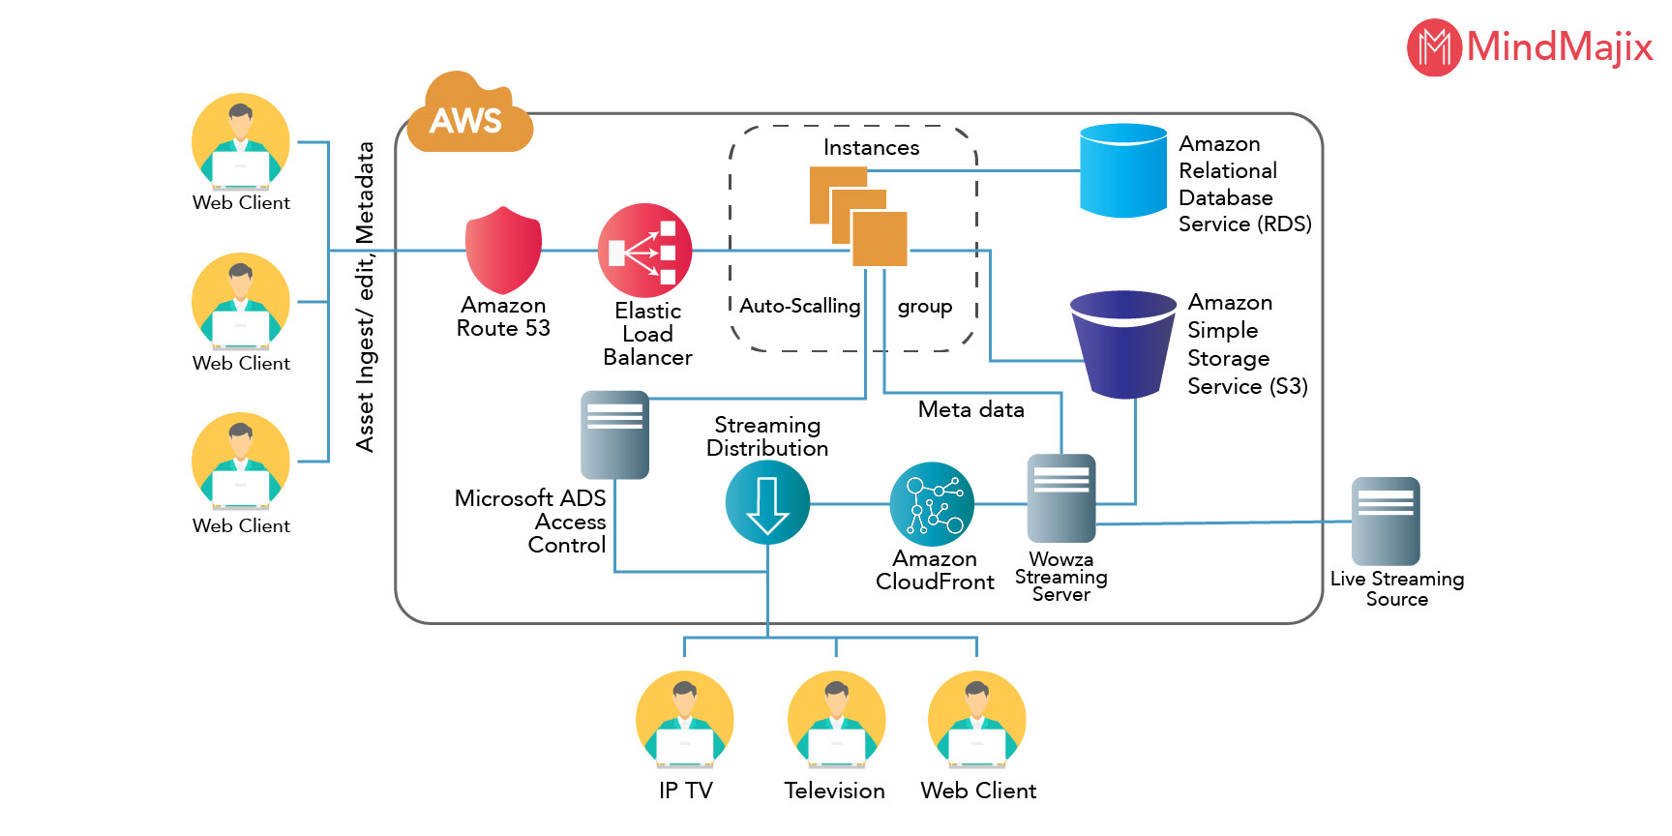
What is AWS Architecture Diagram?

Slide 12
Function of AWS.
It is considered as the basic structure of AWS architecture or AWS EC2. Simply, EC2 is also called Elastic Compute cloud which will allow the clients or else the users of using various configurations in their own project or method as per their requirement.
There are also different amazing options such as pricing options, individual server mapping, configuration server, etc. S3 which is present in the AWS architecture is called Simple Storage Services. By using this S3, users can easily retrieve or else store data through various data types using Application Programming Interface calls. There will be no computing element for the services as well.

Slide 13
What are the Key Components of AWS Architecture?
1. Load Balancing:
The load balancing is a component of the AWS architecture which helps to enhance the application and the server’s efficiency in the right way. According to the diagrammatic representation of AWS architecture, this Hardware load balancer is mostly used as the common network appliance and helps to perform skills in the architectures of the traditional web applications.
It also makes sure to deliver the Elastic Load Balancing Service, AWS takes the traffic gets distributed to EC2 instances across the various available sources. Along with this, it also distributes the traffic to dynamic addition and the Amazon EC2 hosts removals from the load-balancing rotation.

Slide 14
2.Elastic Load Balancing: -
This load balancing can easily shrink and increase the capacity of load balancing by tuning some of the traffic demands and supporting sticky sessions to have advanced routing services.

Slide 15
3. Amazon Cloud Front:
Amazon Cloud Front is mostly used for the delivery of content that is directly used for website delivery. The content in the Amazon Cloud Front can also be the type of content such as static, dynamic as well as streaming content that can also take the usage of global network locations as well. From the user end, the content can be requested in an automatic way based on the nearest location that also shows the diverse effect on the performance which will be enhanced in the right way. There will be no commitments in the monthly wise and the contracts.

Slide 16
4.Elastic Load Balancer:
Elastic Load Balancer is mainly used to deliver the required traffic to the web servers and it also helps to improve the performance in a large manner. This Elastic Load Balancing can easily have growth in a dynamic way and also the load-balancing capacity can be shrunk based on certain traffic conditions.

Slide 17
5. Security Management:
It also makes sure to provide a security feature namely known as security groups. It will also work the same as the inbound network firewall and will also have to specify the ports, protocols, and also source IP ranges where all these can be reached to the EC2 instances. With the help of specific subnets or else IP addresses, the security groups can be configured that can also limit the access to EC2 instances effectively.

Slide 18
6. Elastic Cache:
Amazon Elastic Cache is an efficient web service where the memory cache can be managed in the cloud with ease. This cache plays a vital role in terms of memory management and will also help to reduce the service's load in a reliable manner. It also makes sure to enhance the performance along with the scalability on the tier of the database by caching the information which is used in a frequent manner.

Slide 19
7. Amazon RDS:
Amazon Relational Database Service helps to deliver the same access that is similar to the MySql, Microsoft SQL Server database engine or else Microsoft SQL. These applications, queries, and tools will be useful in the Amazon RDS as well.

Slide 20
What is the Importance of AWS Architecture?
AWS Architecture also makes sure to provide incredible services based on the web technologies, uploading and unloading of virtual servers, the selection service and the service of transferring messages, etc. Moreover, the resources of AWS can be available worldwide and can also be able to deploy solutions exactly where the customers are required of them.

Slide 21
Top 5 Pillars of AWS Well-Architected Framework.
1. Security –
Security is the basic thing that matters a lot in AWS Technology. It is entirely an infra design that can easily serve complete data protection, infrastructure protection, privilege Management of all AWS accounts and identifying the security breach with certain detective controls reliably. Basically, it follows certain design principles that are:-
One can apply security at every level
Implementation of Principle of Least Privilege
Enable Traceability
Secured System Applications, data, and OS Level
Automate Security Best practices

Slide 22
2. Reliability
AWS is a good architecture that has come up with well-planned foundations and monitoring in place with various mechanism rates to handle demand rates as per requirements. The system can easily detect the failure and must come out with an optimized solution. The design principles are in the given way like
Test Recovery Procedures.
Usage of Horizontal Scalability in an increment of system availability.
Recovery from failure in an automatic way.
Add or else Removing resources.
Manage Changes in the automation.

Slide 23
3. Performance Efficiency
Performance Efficiency is kept the focus on the efficient use of computing resources to meet the given requirements in a reliable manner. It is also to maintain efficiency as demand changes and technology evolves. The design principles go in the given way.
Democratize advanced Technologies
Globally Deploying of the given system at a minimal cost of lower latency
To keep aside of operational burden, use a serverless architecture
Various comparative testing and configurations for better performance

Slide 24
4. Cost Optimization
It is one of the main pillars of AWS Architecture that is completely optimizing costs, unused, elimination or else sub-optimal resources. It is most probably considered with the matching supply with demand and being aware of expenditure and optimizes over costs.
The following design principles are delivered in the cost optimization are
Adopting of consumption model.
High benefits values from economies of scale.
Stop investing in Data Center Operations.
Analyzing and Attribute Expenditure.
Usage of Well Managed services for reducing some cost of ownership.

Slide 25
What is Google App Engine ?
Google App Engine is a fully managed, serverless platform for developing and hosting web applications at scale.
or
Google App Engine is a cloud computing platform as a service for developing and hosting web applications in Google-managed data centers.

Slide 26
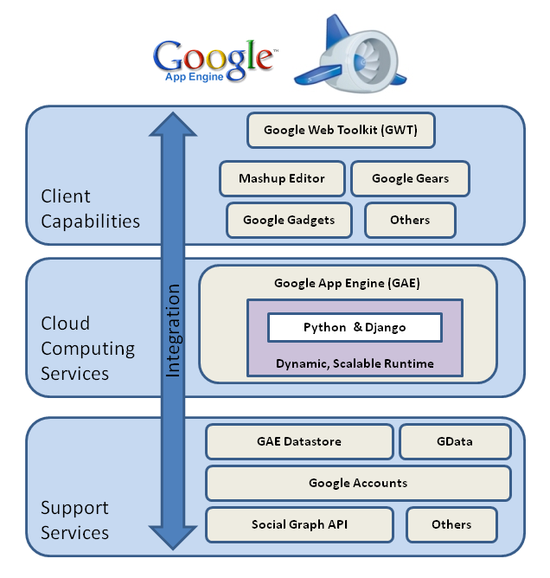
Architecture of google app engine.

Slide 27
Major Features of Google App Engine.
Language support: -
Google App Engine lets users’ environment to build applications in some of the most popular languages, including Java, Python, Node.js, C#, and PHP.
Flexibility: -
Google App Engine offers the flexibility to import libraries & frameworks through Docker containers.

Slide 28
Features of Google app engine.
Traffic splitting:
Google App Engine automatically routes the incoming traffic to different application versions as a part of A/B testing. This enables users to easily create environments for developing, staging, production and testing.
Security:
Google App Engine enables users to define access rules in Engine’s firewall and utilize SSL/TLS certificates on custom domains for free.

Slide 29
Advantages of Google App Engine
Easy to build and use the platform:-
GAE is fully managed which lets developers lay focus on writing code with zero configuration and server management. It handles traffic management by automatic monitoring, patching and provisioning.
Scalability:-
Google App Engine handles the workload fluctuations through scaling the infrastructure, by adding or removing instances or application resources as needed.

Slide 30
Advantages of google app engine.
Various API sets:
Google App Engine has many built-in APIs and services which allows developers to build robust and versatile apps. These features include:
1) Application log Accessibility
2) Blobstore- serve large data objects
3) GAE Cloud Storage
4) SSL Support
5) Google Cloud Endpoint for mobile application

Slide 31
Example of Google app engine.
Examples of Google App Engine:-
One example of an application created in GAE is an Android messaging app which is use to store user log data. The app can store user messages and write event logs to the Firebase Realtime Database and use it to automatically synchronize data across devices.

Slide 32
THANKS

